Slide 1

A Little About
Juvenile Arthritis

Slide 2
A Little About ME!
My name is:
I was born in:
My pet’s name is:
I have: (your type of arthritis)
I was diagnosed when I was: (age)
Insert Picture Here

Slide 3
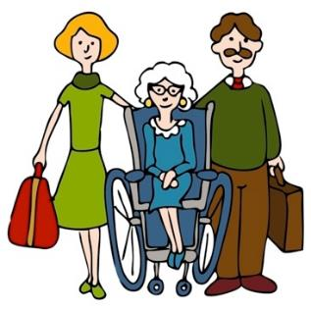
Never Heard of Juvenile Arthritis?
That’s OK! Most people haven’t heard of it. Lots of people think that only old people get arthritis, but that’s not true!

Slide 4


Juvenile Arthritis Is REAL!
There are many types of arthritis. Some types affect only kids.
IT’S A FACT! 300,000 babies, children and teens have juvenile arthritis!

Slide 5
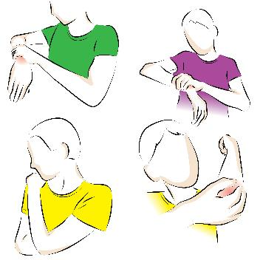
Imagine…
All of a sudden a joint, like your wrist or your elbow, swells up and starts to hurt A LOT.
Then your doctor says you have a chronic disease, which means it can’t be cured.
Not all surprises are fun ☹

Slide 6
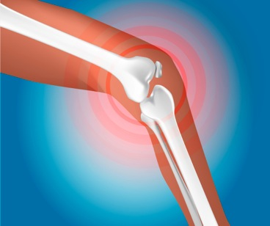
What is Arthritis?
Arthritis is a disease of the joints.
Joints are where bones meet. They let you bend and move.
In kids, arthritis is an autoimmune disease. This means the immune system, which normally protects against germs and viruses, gets confused and attacks the joints instead.
Examples:
  Wrist joints
  Finger joints
  Knee joints
  Elbow joints

Slide 7
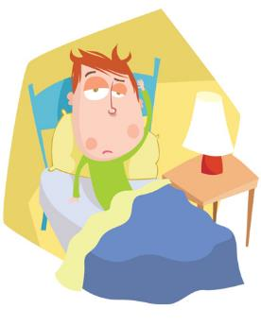
More than Joints
All sorts of things can go wrong when you have JA, but it mostly makes your joints hurt a lot.
Some types of JA can also make you really sick, including:
  High fever
  Skin rash
  Super tired
  Loss of vision
  Harm to heart, lungs and other organs

Slide 8

Why Do Kids Get JA?
Nobody knows. Scientists are searching for answers.
They DO know it’s NOT contagious.
There ARE clues. It may have something to do with the genes you are born with and how they interact with your environment, like a germ or virus.
For the most part, it’s still a MYSTERY!

Slide 9
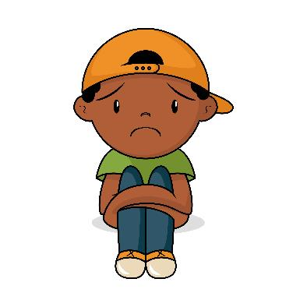
Mostly Invisible
You might see swollen joints, like fingers or knees.
A lot of times, you can’t see that anything is wrong.
But the pain is STILL there.

Slide 10


Pain Comes and Goes
Kids with JA never know what to expect. Some days they might feel bad in the morning, but will feel better later in the day.
Morning
Afternoon

Slide 11

JA and School
At school, sometimes these things can be difficult:
  Walking far
  Carrying books
  Holding a pencil
  Writing
  Doing exercises in P.E.
  Playing at recess

Slide 12

Every Kid Is Different
Some kids are taller than others, some kids wear glasses and some have a disease like arthritis.
Kids who have JA may have painful joints, have to go to the doctor a lot and get tired easily, BUT…They are just like any other kid. Arthritis is only ONE thing about them!

Slide 13

Let’s Find a CURE!
You can HELP families and kids like me with arthritis.
Please join my team and help me raise money to find a cure!
My team name is:
Sign up at: (paste hyperlink to team page)
We have to fight for a cure so one day kids won’t have to feel this pain!

Slide 14
Thanks for Listening ☺
Questions?

